Slide 1

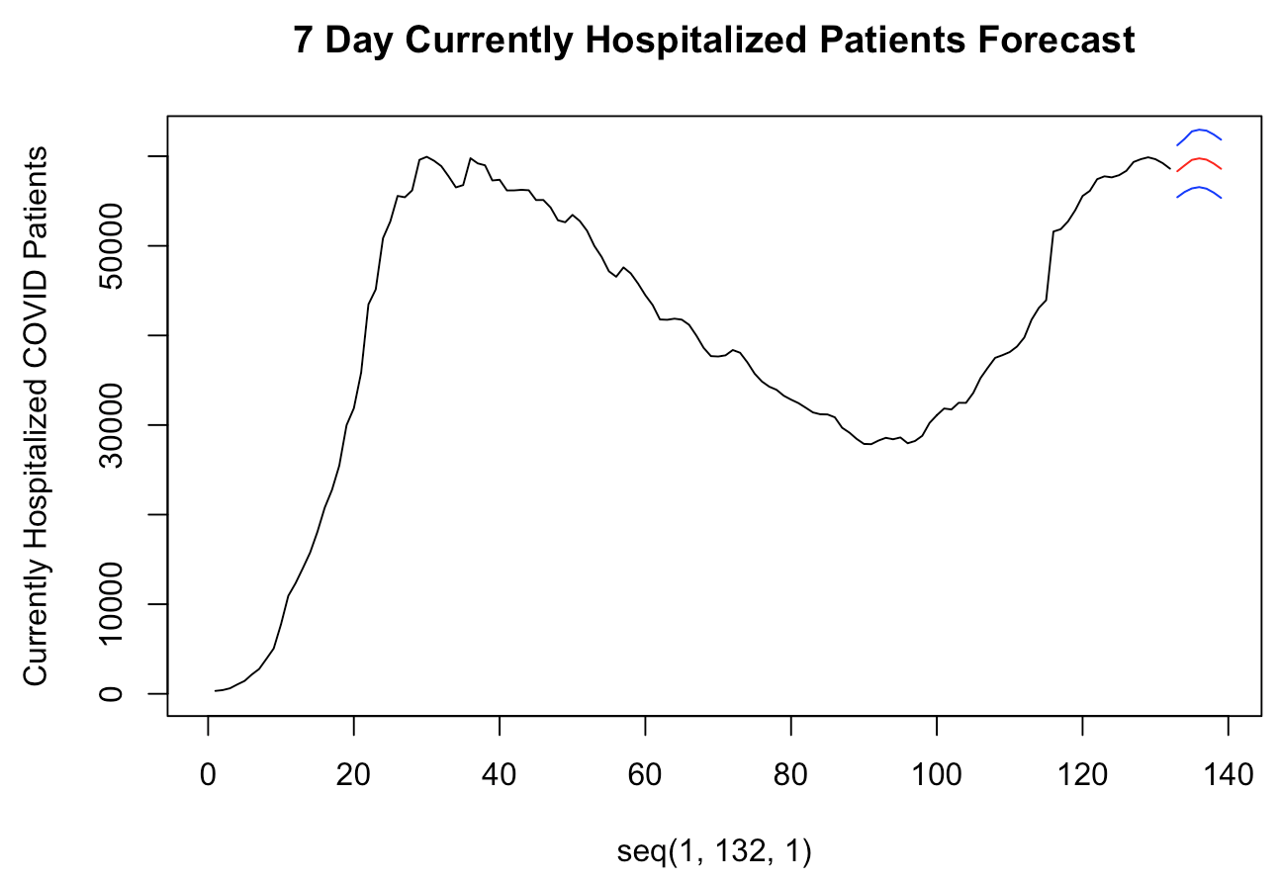
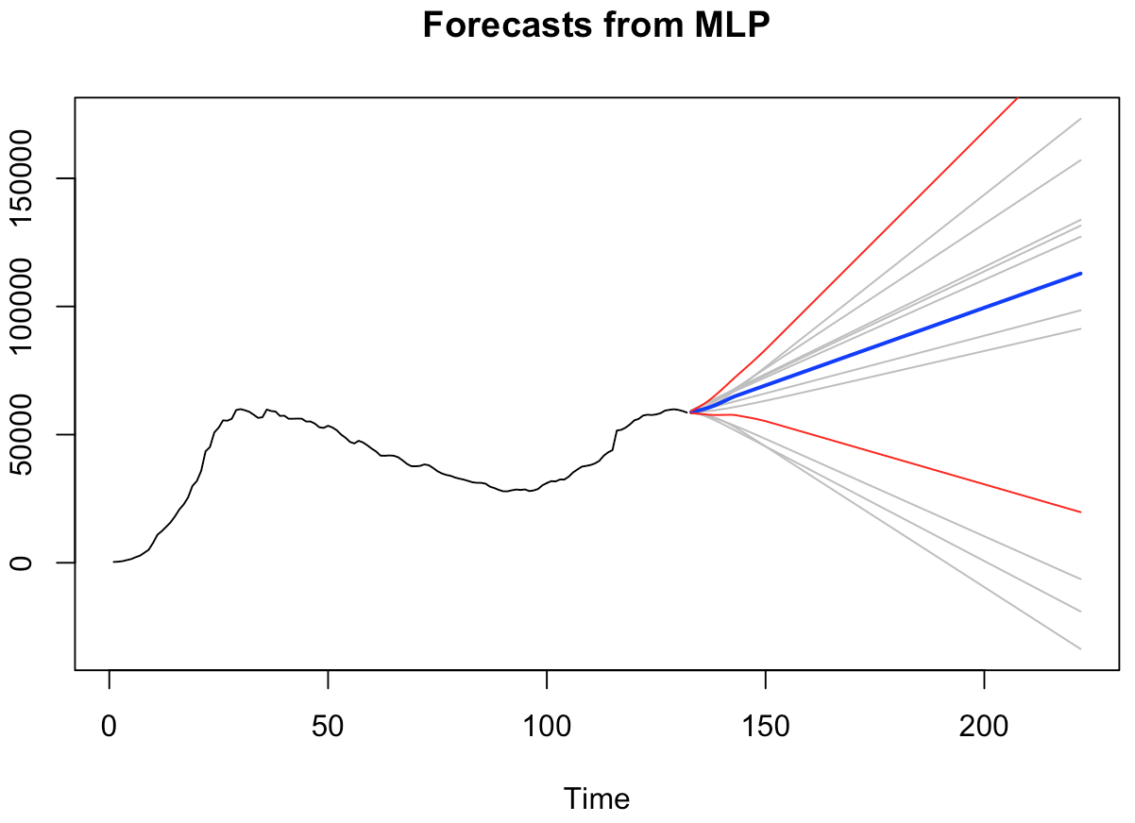

United states: final model analysis
7-Day Forecast
Univariate MLP: 12,177,586
Multivariate VAR: 5,178.55
90-Day Forecast
Multivariate MLP: 13,970,241
Notes:
Jaclyn
Time:7
For our final forecasting models we have chose those that seem the most useful based on ASEs and flexibility for daily updates.

Slide 2

United states: final model analysis
7-Day Forecast
Univariate MLP: 12,177,586
Multivariate VAR: 5,178.55
90-Day Forecast
Multivariate MLP: 13,970,241
Notes:
Jaclyn
Time:26
We recommend leveraging the multivariate VAR model for short term forecasts. The VAR model bases predictions off of previously observed values and takes into account the heavy wandering and seasonal components in the data. Using the VAR method will be the most useful in order to get us prepared for completing short term planning for supplies and hospital staffing. We’ve included prediction intervals to help us make sure we account for possible peaks and valleys in our forecast.

Slide 3

United states: final model analysis
7-Day Forecast
Univariate MLP: 12,177,586
Multivariate VAR: 5,178.55
90-Day Forecast
Multivariate MLP: 13,970,241
Notes:
Jaclyn
Time:15
For our long term forecasting we have chosen to go with our hyper tuned parameter mlp model. This model is helpful because it has the ability to adjust and apply the most effective parameters based on the newest data.` We’ve also included prediction intervals to, again, account for possible peaks and valleys in our forecasts.

Slide 4

United states: final model analysis
7-Day Forecast
Univariate MLP: 12,177,586
Multivariate VAR: 5,178.55
90-Day Forecast
Multivariate MLP: 13,970,241
Notes:
Jaclyn
Time:15
It is essential for the continued accuracy of both of these models for them to be updated daily. COVID cases and hospitalizations change frequently and the only way to continue to forecast and prepare as effectively as possible is to have updated models with as much historical data as possible.

